Slide 1
Digital Fundamentals
CHAPTER 7 Latches, Flip-Flops and Timers

Slide 2
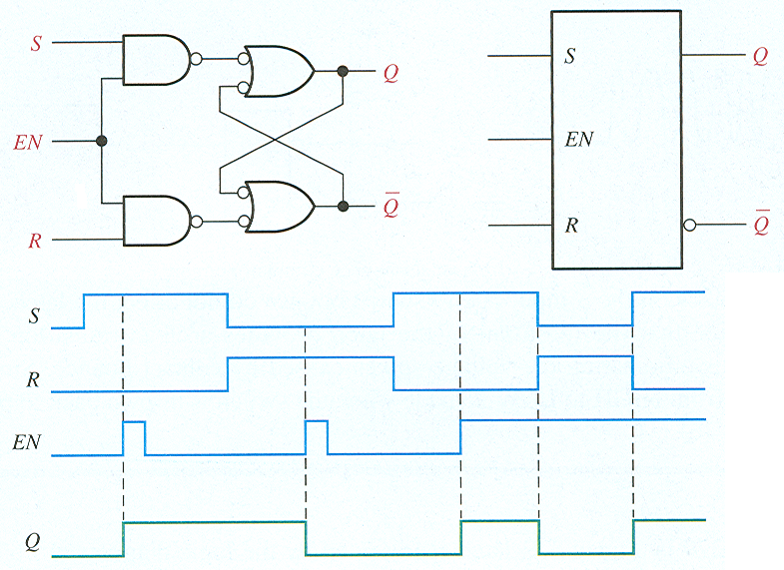
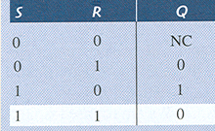
Gated S-R latch
Find output given the inputs. EN enables the gate. Output is frozen unless EN is high.

Slide 3
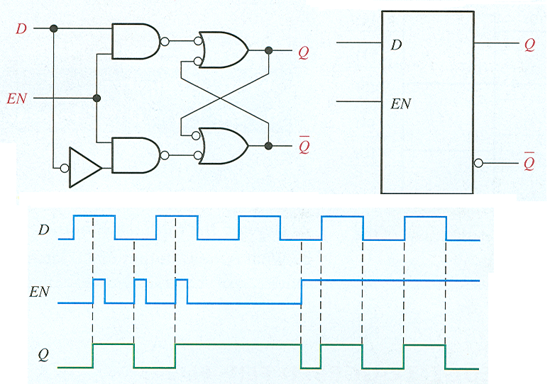
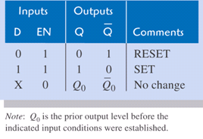
Gated D latch
Find output given the inputs. EN enables the gate. Output is frozen unless EN is high.
The D latch is like the S-R latch, but only has one input.
No invalid state for D latch.
Output will follow input as long as EN is HIGH.

Slide 4
Edge-Triggered Flip-Flops
Flip-flops are synchronous bistable devices
synchronous means that the output changes state only at a specified point (leading or trailing edge) on the triggering input called the clock (CLK),
Edge-triggered S-R flip-flop
Edge-triggered D flip-flop
Edge-triggered J-K flip-flop
An edge-triggered flip-flop changes state either at the positive edge (rising edge) or at the negative edge (falling edge) of the clock pulse

Slide 5
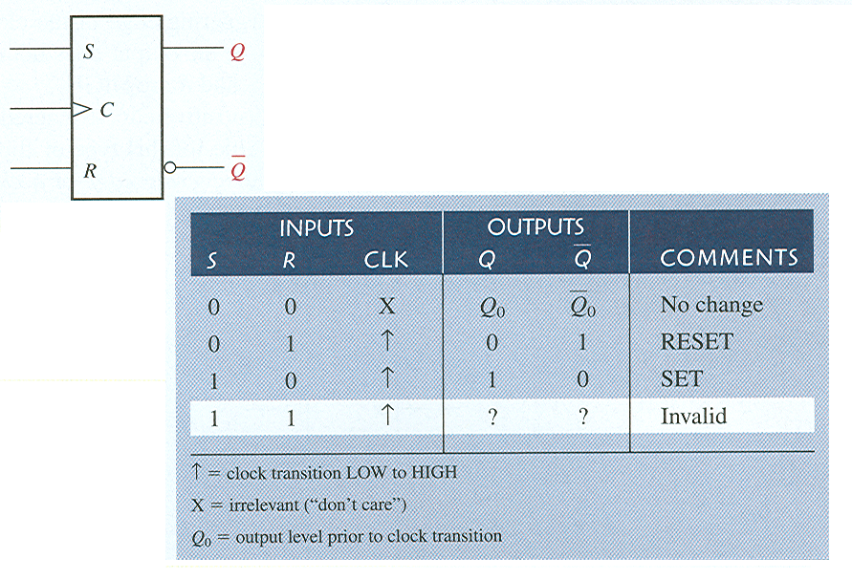
Edge-Triggered Flip-Flops
Edge-triggered S-R flip-flop
Waveforms

Slide 6
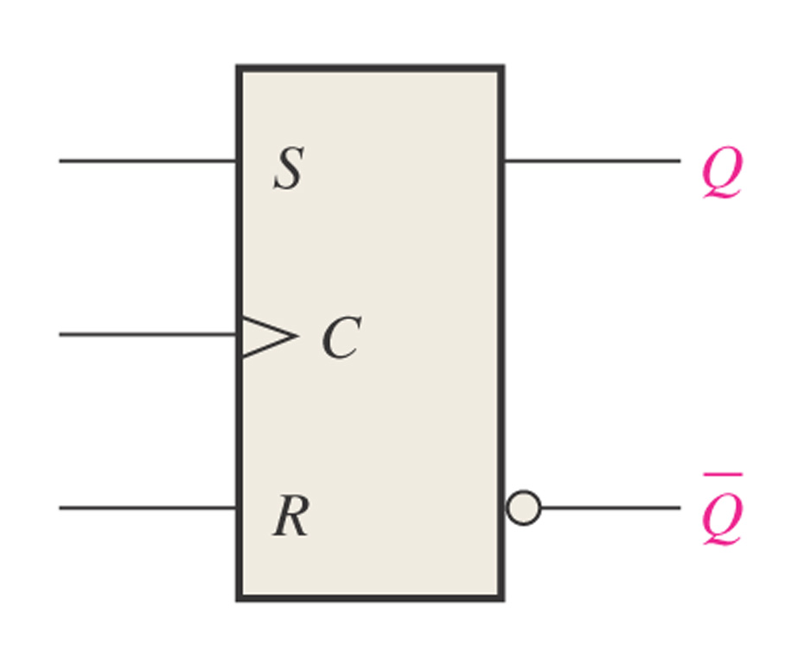
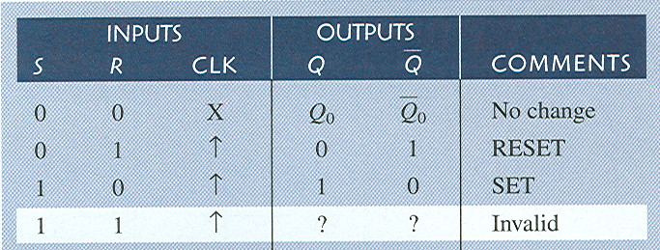
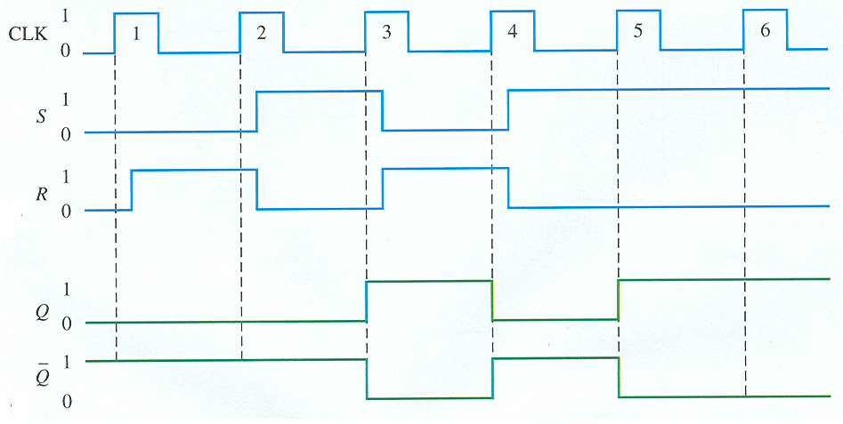
Find outputs for given inputs for S-R positive edge-triggered flip-flop. Assume output is initially LOW.

Slide 7
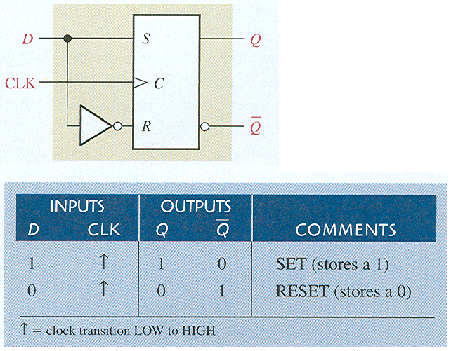
Edge-Triggered D Flip-Flop
Edge-triggered D flip-flop is formed with S-R flip-flop and an inverter.
Waveforms

Slide 8
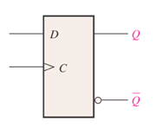
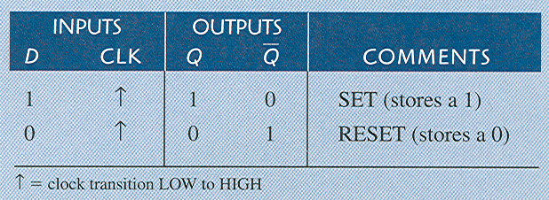
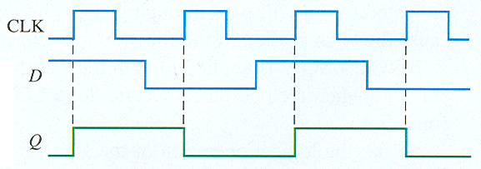
Edge-Triggered D Flip-Flop
Find output for D flip-flop if Q is initially LOW.

Slide 9
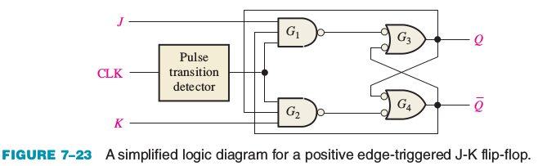
Edge-Triggered Flip-Flops
J-K flip-flop

Slide 10
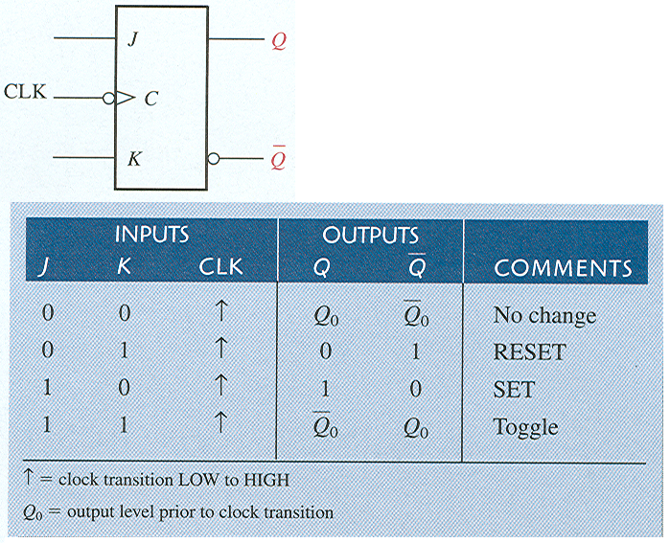
Edge-Triggered Flip-Flops
Edge-triggered J-K flip-flop
Falling edge of clock (active low)
Waveforms
HIGH to LOW

Slide 11
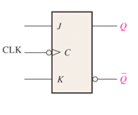
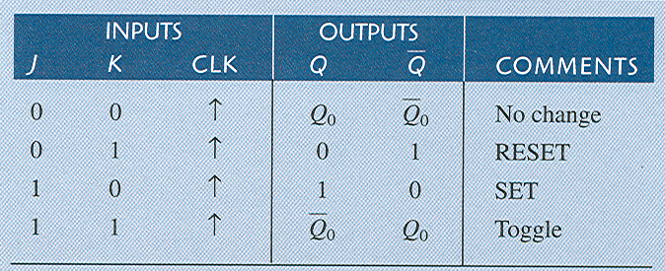
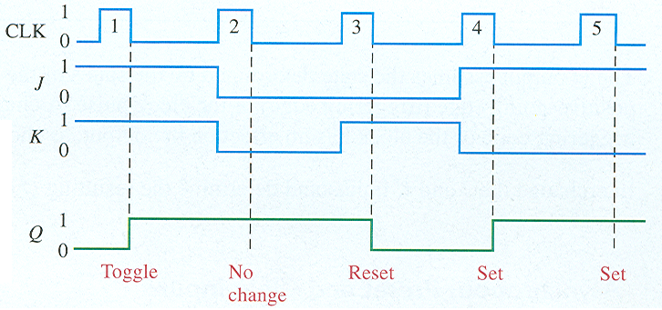
Edge-Triggered J-K Flip-Flop
Find output for given inputs to J-K flip-flop if Q is initially LOW.
Note that clock has bubble, so output changes on negative-going edge of clock pulse.

Slide 12
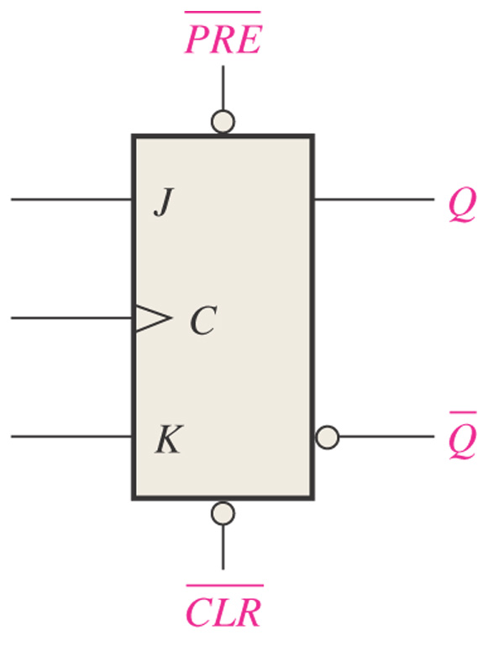
Logic symbol for a J-K flip-flop with active-LOW preset and clear inputs.
If Preset is low, then Q will be high.
If Clear is low, then Q will be low.
Both have to be high for flip/flop to work properly, since they override the J, K, and Clock inputs.

Slide 13
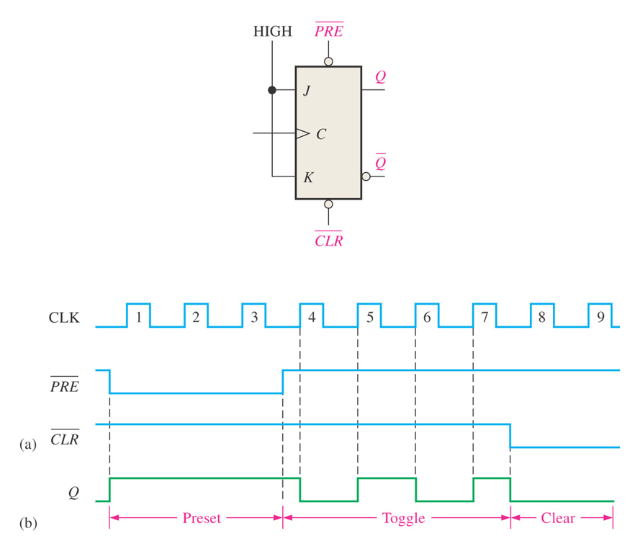
Determine Q output given the inputs shown. Assume Q is initially LOW.
Clock doesn’t have bubble, so Q will change on rising edge.
J and K are both tied High, so output will toggle on each rising edge of clock.

